Slide 1
Ancient India
Early Indian Societies
Aryans and Indian Culture

Slide 2
Early IndianSocieties
Harappan Cities
  Urbanization
    Mohenjo-Daro
      North-south grid pattern
      Cesspits
  Language and Ethnicity
    Dravidian
  Trade

Slide 3
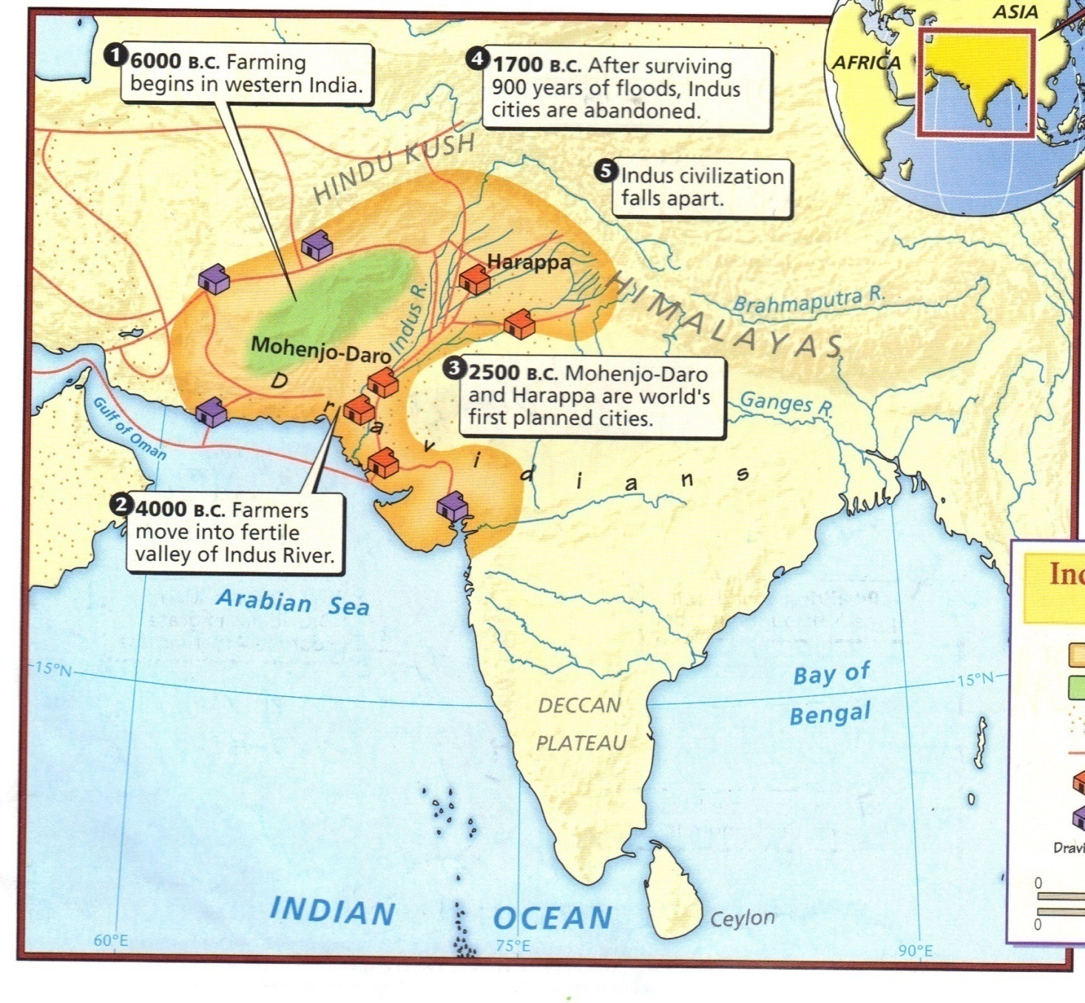

Slide 4
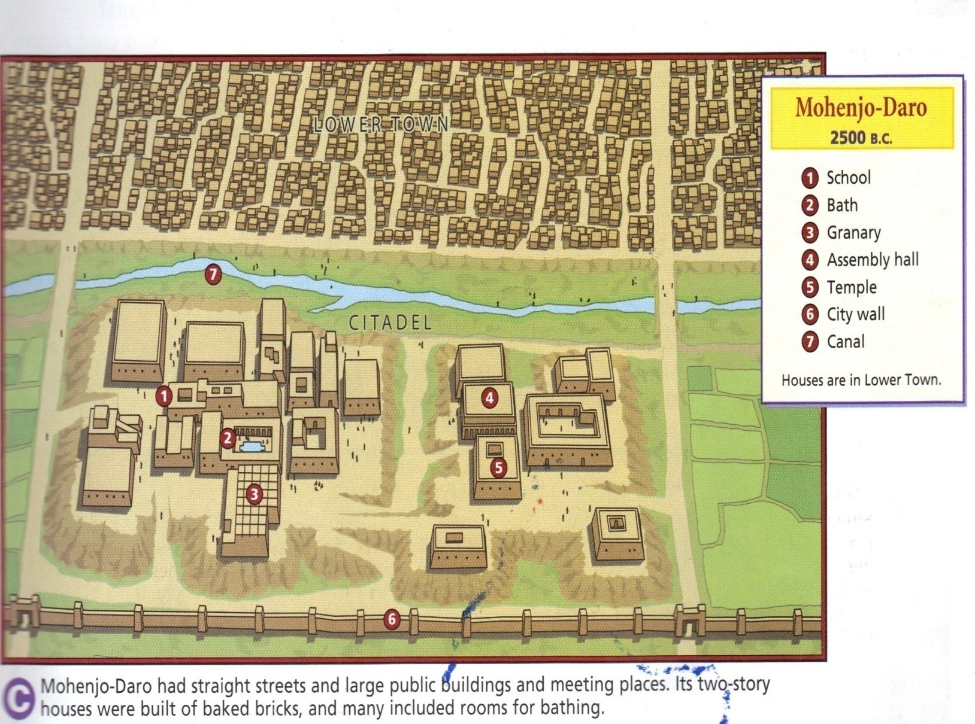
Mohenjo-Daro

Slide 5
Aryans and Indian Culture
Aryan Invasion
  Tribal
    Warrior king – Raja
  Patriarchal
Political Organization
  Mahabharata
      Dharma
  Caste System (Varna)
      Brahmins
      Kshatriyas
      Vaishyas
      Shudras

Slide 6
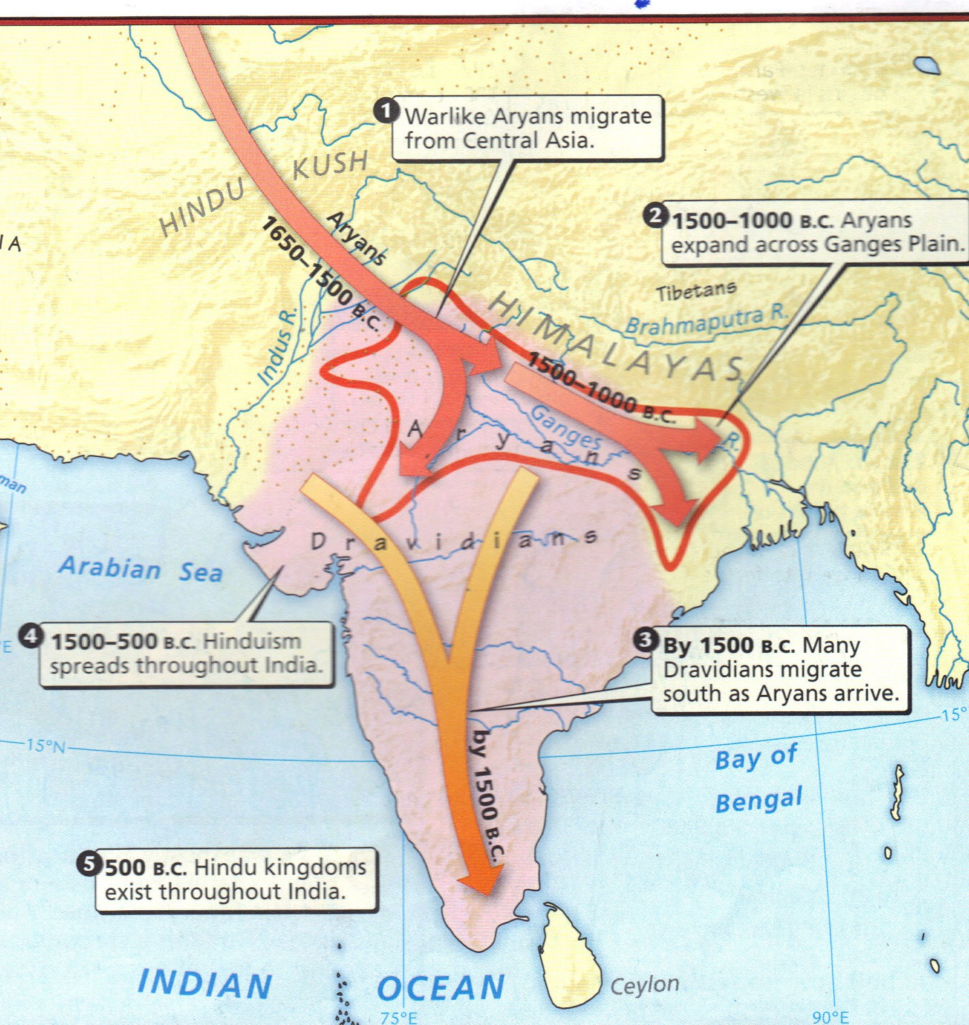
Aryan Invasion

Slide 7
Aryans and Indian Culture (cont’d)
Culture
  Language
    Sanskrit
  Vedas (1400 to 900 BCE)
    Bhagavad Gita
    Rig Veda
    Brahmanas
      Karma-Samsara
    Upanishads
      moksha

